Slide 1

Industrial Training - ETP
Name : Sonali Kumari Course Code : CAP-841
Reg No. : 12214609 Industrial Training
Program : MCA ( 4th Sem. )

Slide 2


Slide 3
About the Company
TRADELINKEXPORT focuses on the small B2B sector, offering comprehensive services to small and medium-sized enterprises (SMEs) engaged in the cross-border e-commerce industry. Our suite of services includes:
• Store Operation: Expert management and optimization of online stores to ensure maximum visibility and sales.
• Traffic Marketing: Strategic marketing solutions to drive quality traffic and enhance online presence.
• Warehousing and Logistics: Efficient storage and distribution solutions to streamline supply chain operations.
• Payment and Finance: Secure and reliable payment gateways and financial services to facilitate smooth transactions.
• Customer Service: Dedicated support to address customer queries and provide a seamless shopping experience.

Slide 4
• Risk Control: Advanced risk management solutions to safeguard businesses from potential threats.
• Customs Inspection and Remittance: Comprehensive support for customs clearance and remittance processes.
• Business Training: Educational programs to equip businesses with the knowledge and skills needed to thrive in the digital marketplace.

Slide 5
Our Core Values
Our commitment to our customers is paramount. Every process we undertake is designed to enhance the user experience through technological transformation and innovation. We are driven by a unified purpose: to build long-term relationships that create a significant impact not only on our customers' businesses but also on their lives. We strive to provide solutions that go beyond mere transactions, fostering growth and success on a personal level.
Our Vision
At TRADELINKEXPORT, technology and innovation are the cornerstones of our mission. We aim to help our users reinvent their businesses, enabling them to compete and win in the digital age. Digitization is at the core of our strategy, and we are proud to be the only marketplace offering 360° solutions to suppliers and MSMEs, empowering them to become tech-enabled. With a strong presence across India and a global footprint in over 10 countries, we are committed to driving growth and excellence in the SME sector.

Slide 6
Project : TWT ( Trade with TradeLinkExport )
Description:
The Trade with TradeLinkExport (TWT) is an ambitious initiative aimed at revolutionizing the cross-border e-commerce landscape for small and medium-sized enterprises (SMEs). As part of TRADELINKEXPORT, TWT will provide a comprehensive digital platform offering end-to-end services including store operation, traffic marketing, warehousing and logistics, payment and finance, customer service, risk control, customs inspection and remittance, and business training. This platform will empower SMEs to seamlessly manage and grow their businesses in the global market.

Slide 7
Working :
Prioritize customer satisfaction and build long-term relationships.
Leverage cutting-edge technologies for innovative solutions.
Develop impactful solutions that benefit businesses and customers' lives. Note :
I am not allowed to mention project details due to a non-disclosure agreement (NDA) signed with the project stakeholders, I am unable to share any specific details of the project in the report. As per the NDA requirements, This certificate affirms my commitment to maintaining the confidentiality of the project information and ensures compliance with the terms and conditions outlined in the NDA.

Slide 8
User Interface Of Project

Slide 9
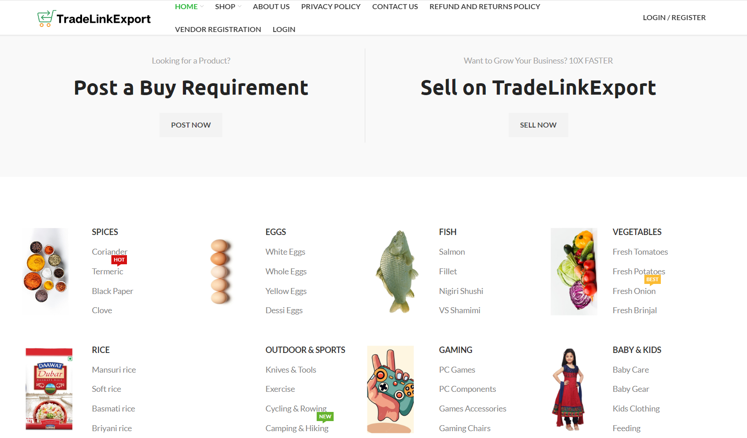

Slide 10


Slide 11
Job Description and Learnings
I started my job in “TradeLinkExport” as a Software Developer - Intern and at the time of my training period, I learnt these technical skills.
Technical Skills Backend Development using NodeJS and Express
Learning React for frontend development
Learning different tools to call API and run in local
Experienced in using Git for version control to manage and track changes in software projects, Utilized Git for maintaining project histories, reverting changes, and ensuring code integrity in multi- developer environments.
API development for the Real Time Web Application
Experienced with MongoDB, getting data from frontend and saving that in database and fetching the data from database.
Adapting the domain and learning the application how to debug inside the application.

Slide 12
Project Non Disclosure Agreement (NDA)

Slide 13
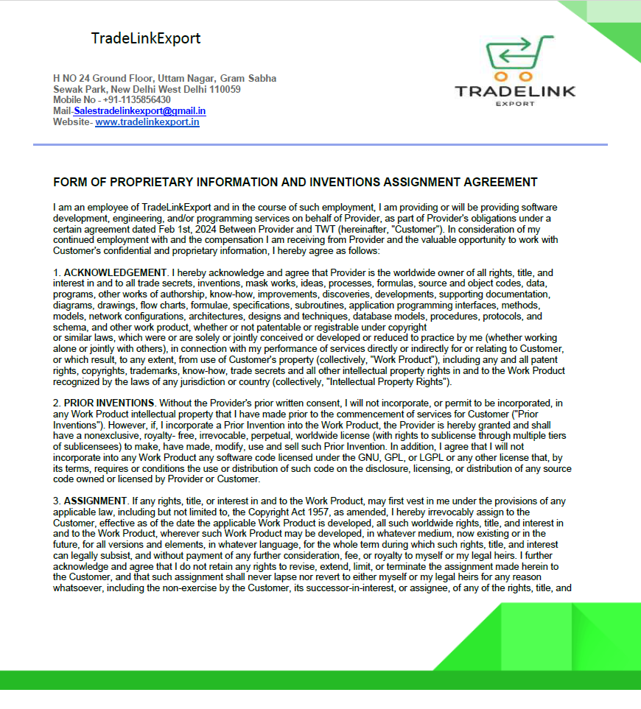

Slide 14
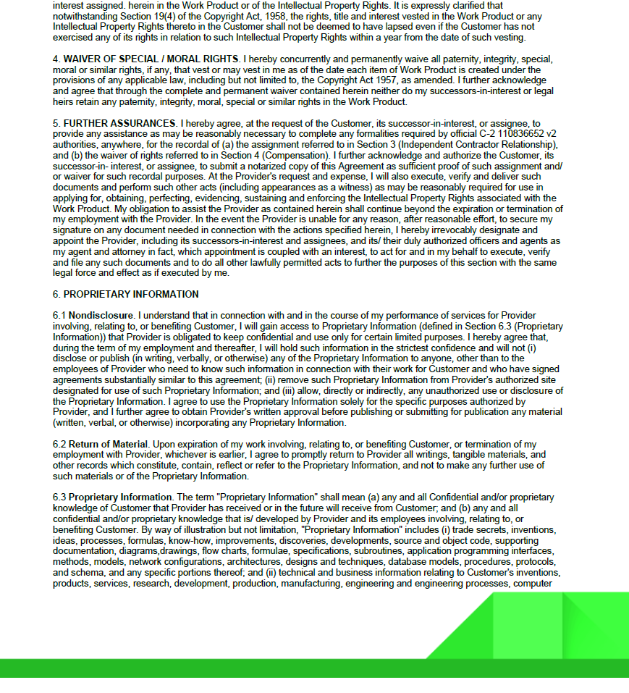

Slide 16
Evaluation By the External Mentor

Slide 17
Thank You

